Slide 1
LeaderSTeM - A LSTM model for dynamic leader identification within musical streams
Sutirtha Chakraborty¹, Shyam Kishor², Shubham Patil³, and Joseph Timoney¹
¹ Maynooth University, Ireland
² Genpact, Bangalore
³ SVNIT, India
Email- sutirtha.chakraborty@mu.ie

Slide 2
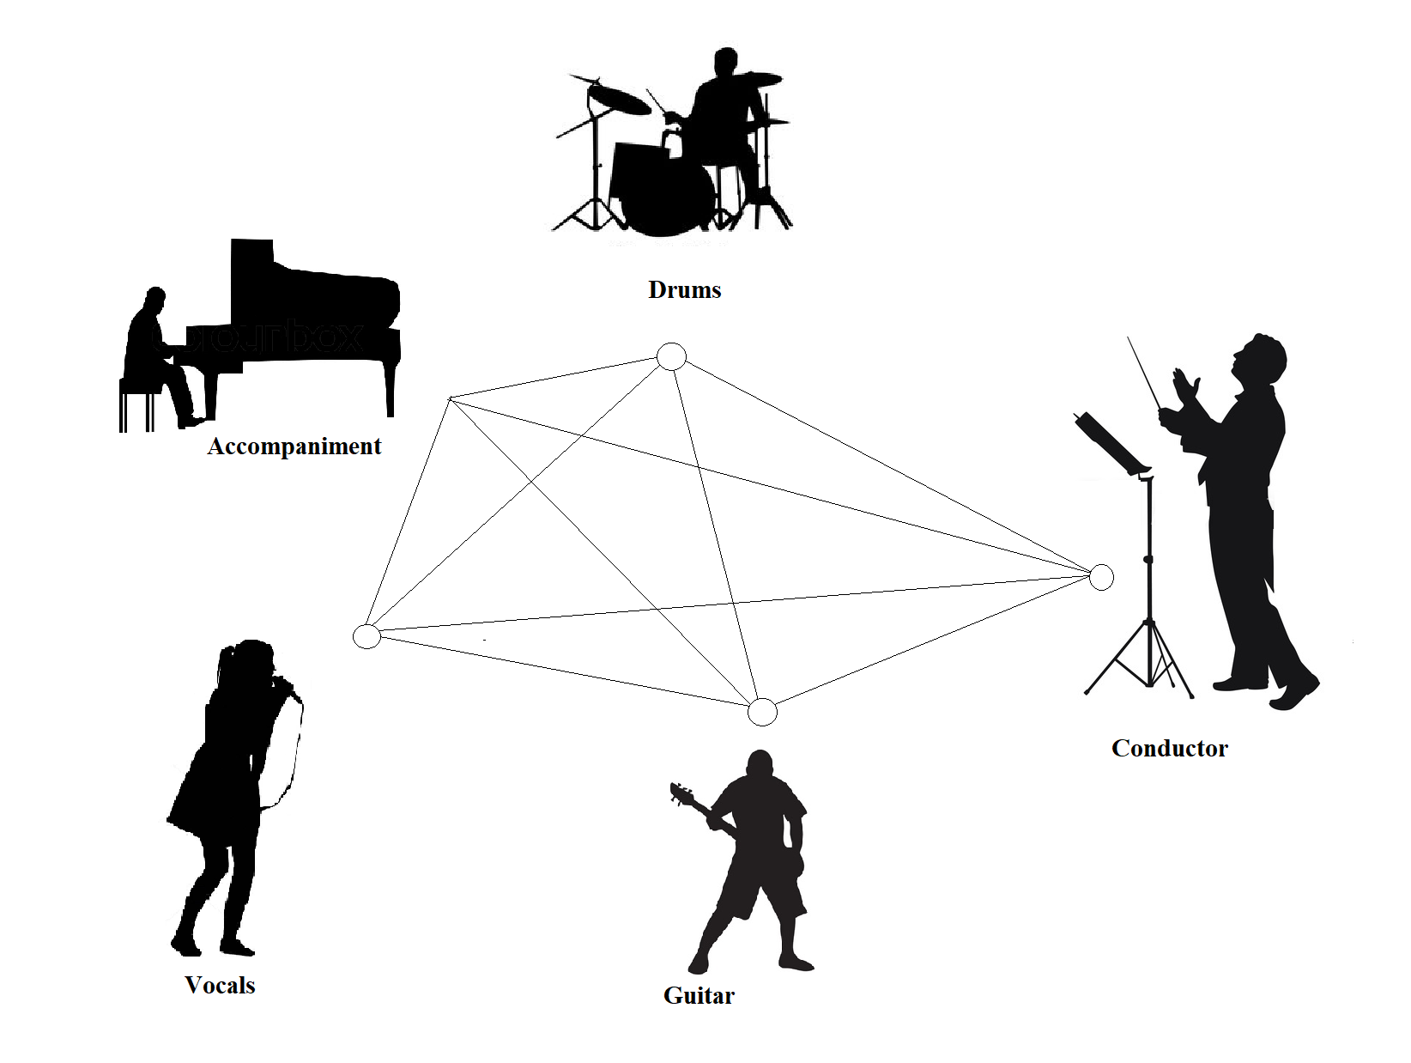
Musical Ensemble
A musical ensemble is a collaborative performance of vocal and/or instrumental music by a group of musicians and singers

Slide 3
Ensemble Network
Inter-connected network
Leader-Follower Relationship among Musicians
Time-varying leader-follower

Slide 4
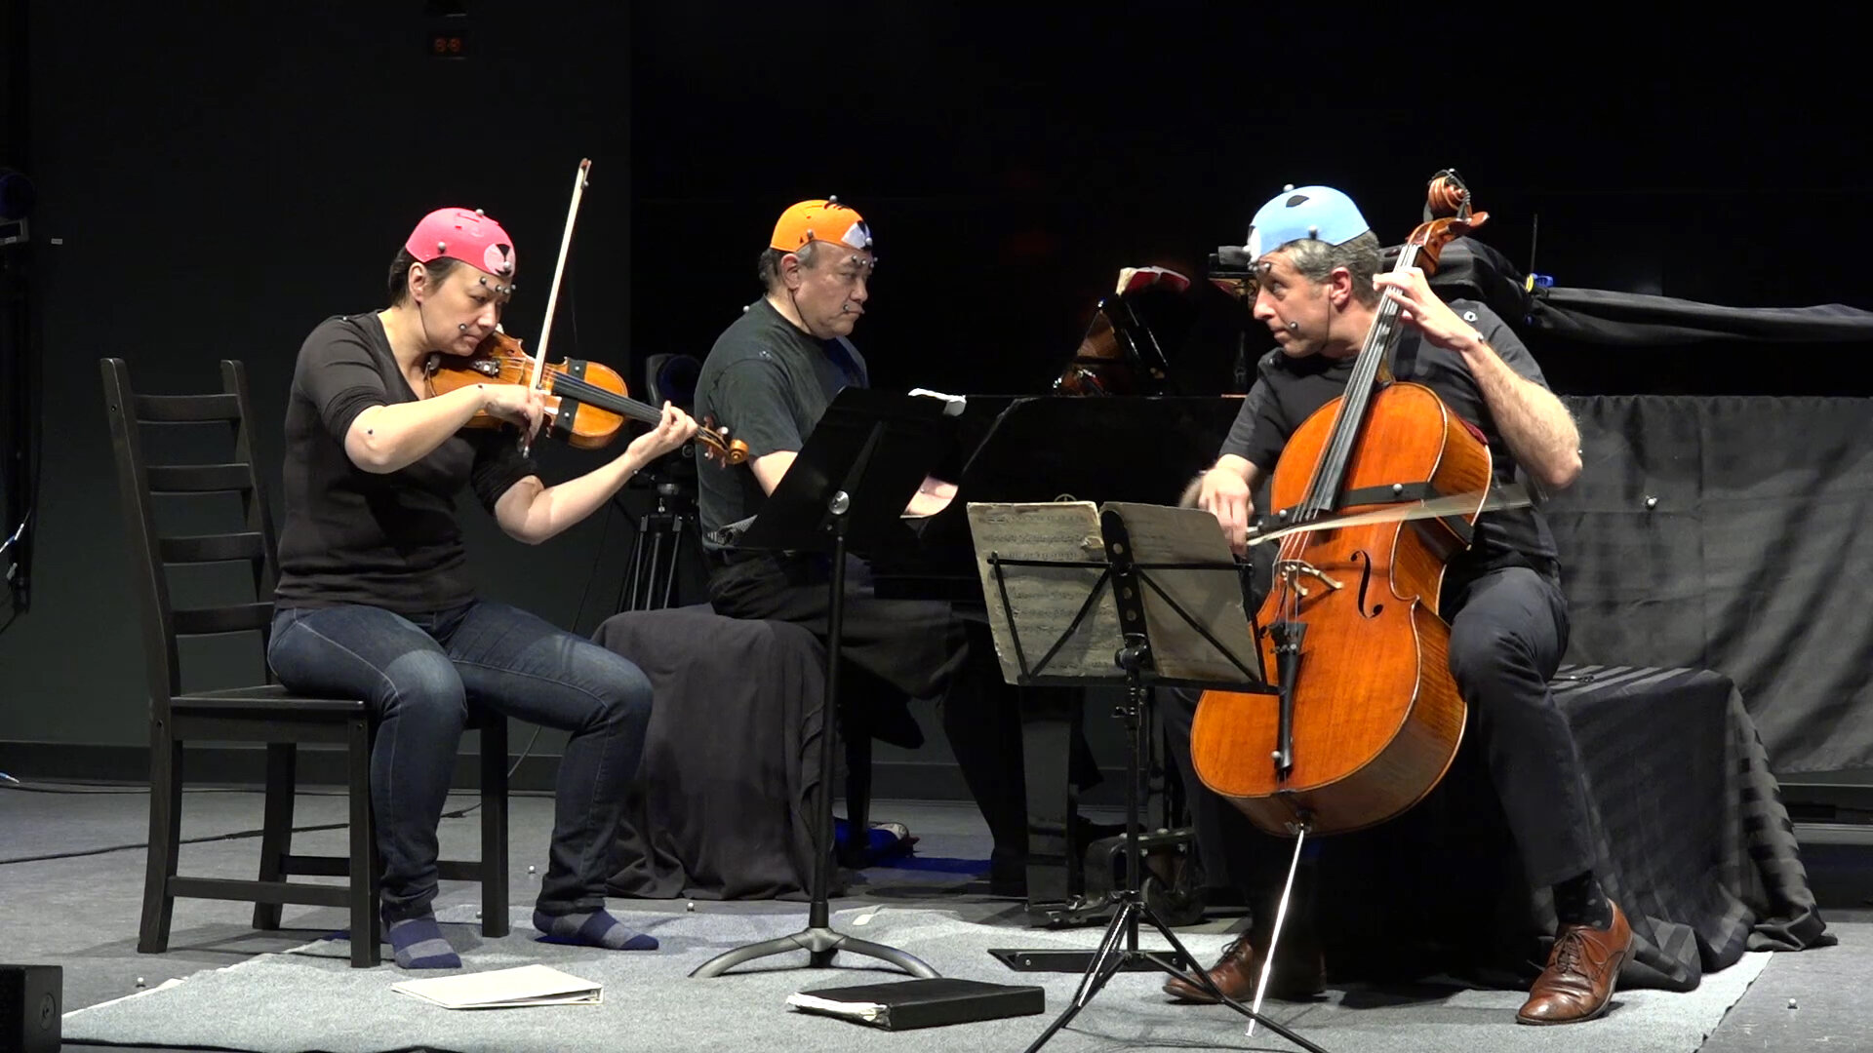
State of the Art
Audio Perception
Non-Verbal Communications
Visual Gaze
Body Sway

Slide 5
Problem Statement
Tracking the Leader’s tempo from audio features only ?

Slide 6
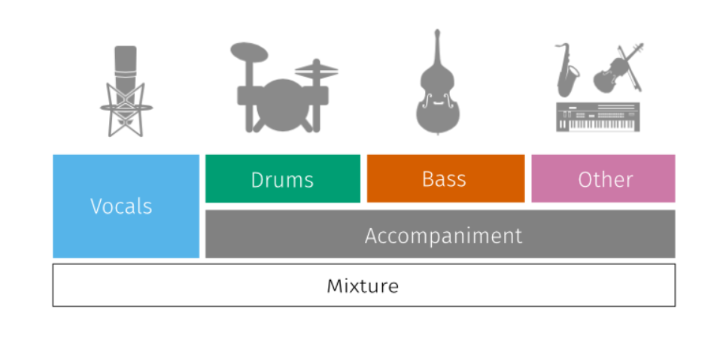
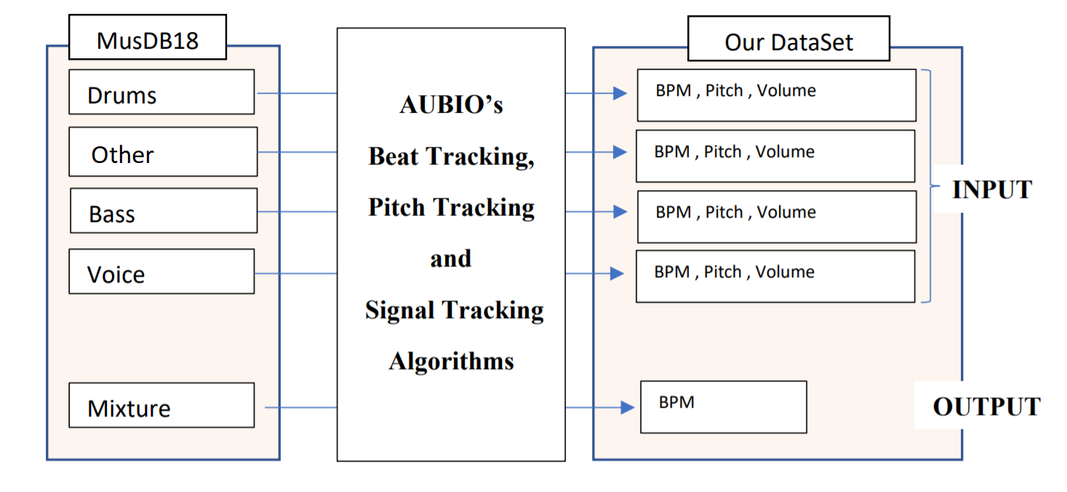
Preparing the Dataset
Used Aubio Beat Tracking
- Window size of 1024
- Hop-size 512
- Sampled at 44.1kHz

Slide 7
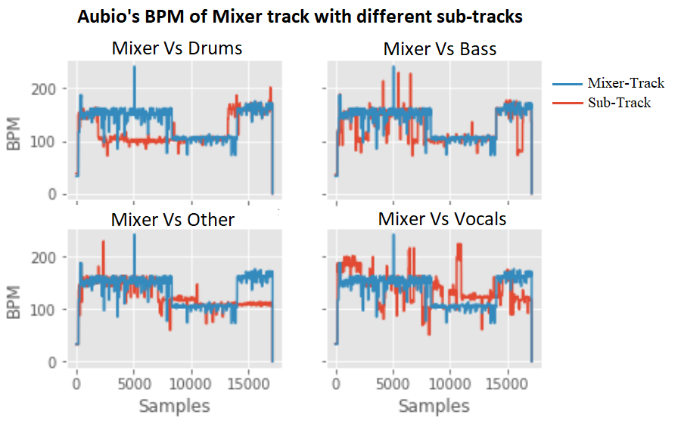
Preparing the Dataset
1st Part –
Mixer follows the Other
2nd Part –
Mixer follows the Drums
3rd Part
Mixer follows the Bass

Slide 8
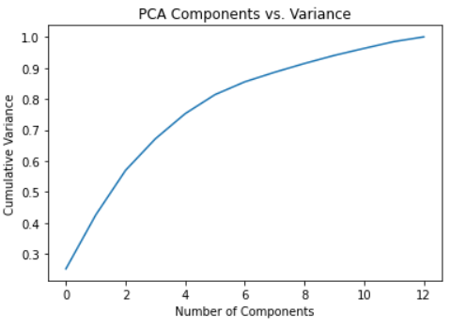
LeaderSTeM Model
Data Set
PCA
Modelling
SVM
Random Forest
LSTM
3 Layered
4 Layered
5 Layered

Slide 9
LeaderSTeM Model
LeaderSTeM Model
Modelling
SVM
Random Forest
LSTM
Performance
LSTM
3 Layered
4 Layered
5 Layered
3 Hidden layer LSTM model

Slide 10
LeaderSTeM Model
LeaderSTeM Model
Search space for LSTM Model
Input shape 13,1
Learning Rate 0.001 – 0.1
Number of nodes in hidden layer 2 - 512
Number of hidden layers 3 - 5
Activation Function ReLU
Epochs 10
Batch Size 32
Best Model
Learning Rate | Unit 1 | Unit2 | Unit3 | Mean Squared Error
0.082 | 445 | 481 | 37 | 245

Slide 11
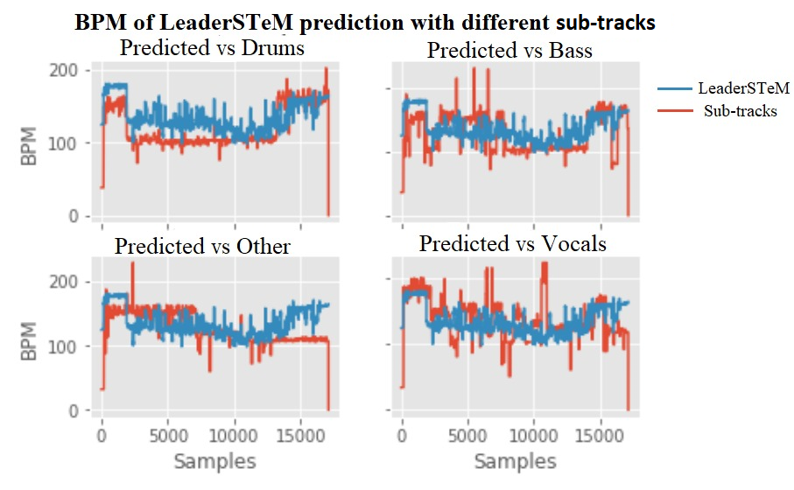
LeaderSTeM’s Prediction

Slide 12
Conclusion

